Slide 1
Predicting NBA All Stars
Kevin Sun

Slide 2
Process
Scrape NBA player season averages from Basketball-Reference
Clean the data, feature engineering
Exploratory Data Analysis
Use models to make predictions

Slide 3
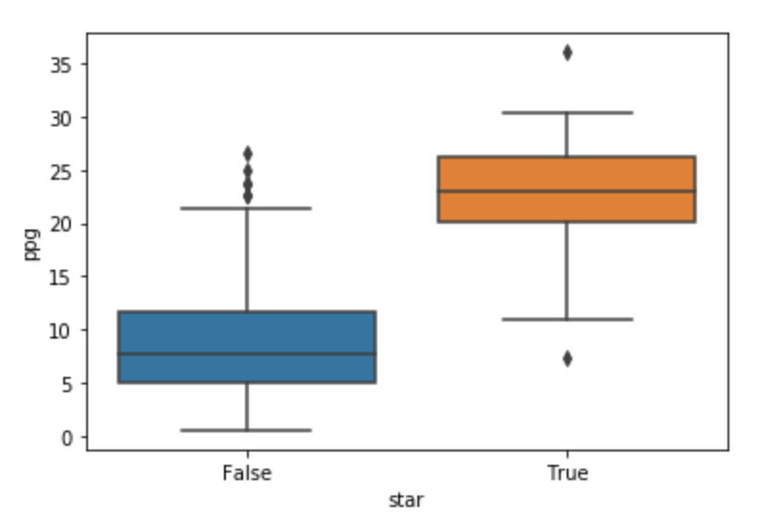
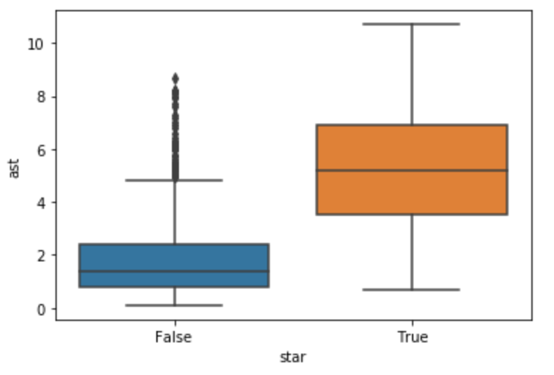
All Stars vs NBA

Slide 4
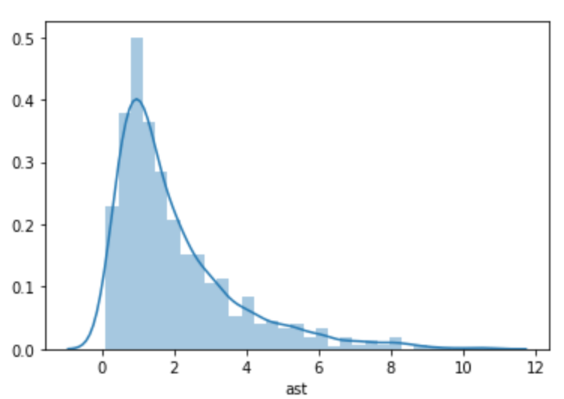
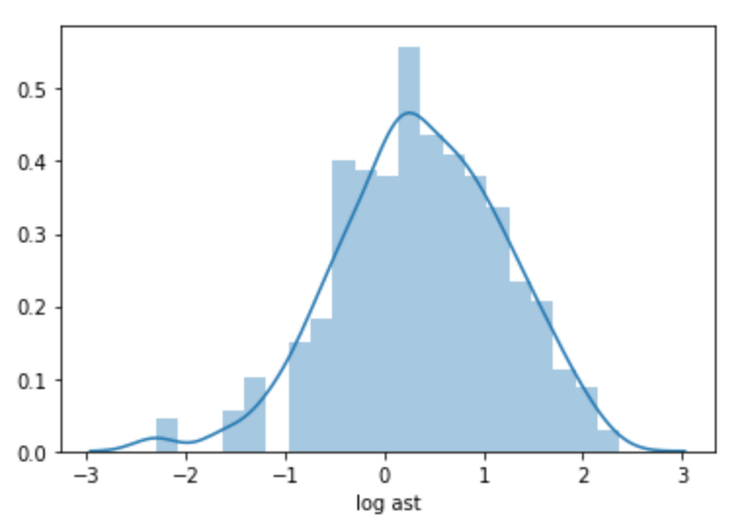
Skewed Features

Slide 5
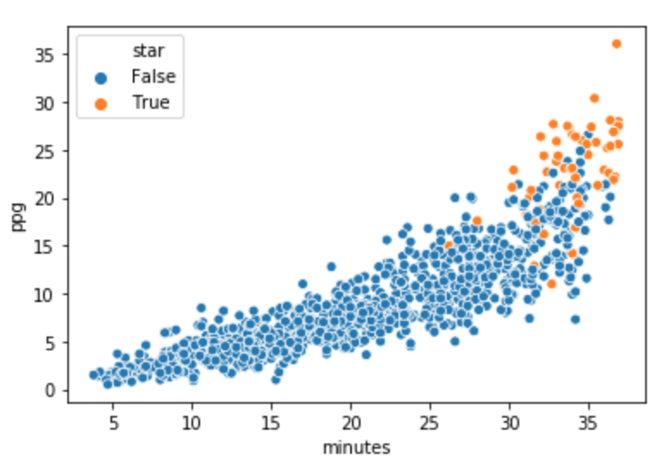

Slide 6
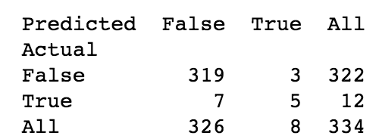
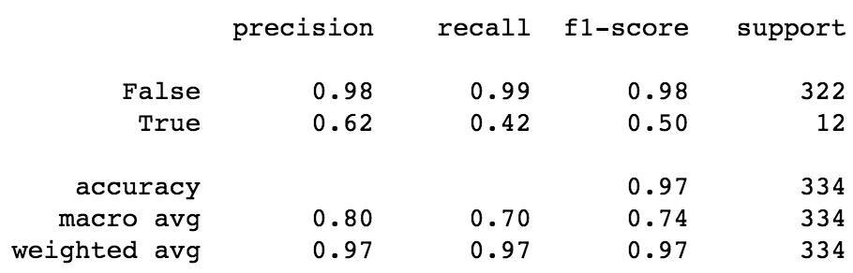
Logistic Regression

Slide 7
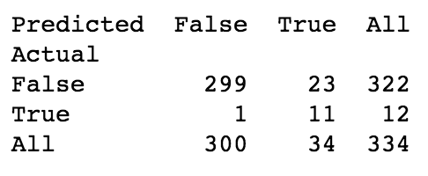
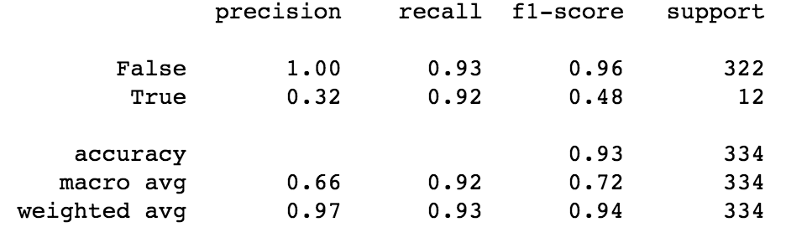
Logistic Regression (SMOTE)

Slide 8
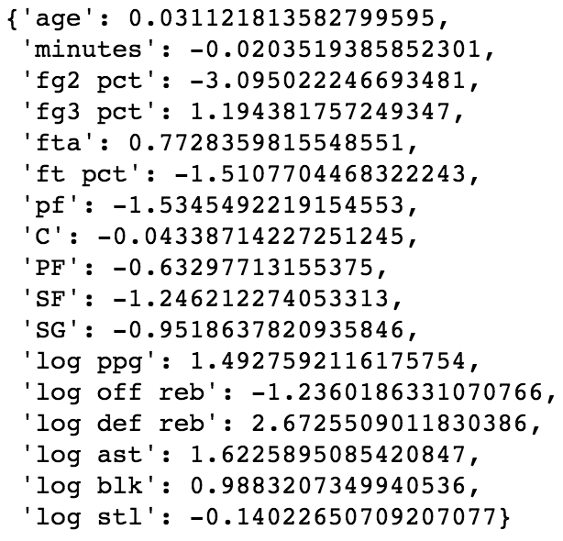
Logistic Regression Coefficients

Slide 9
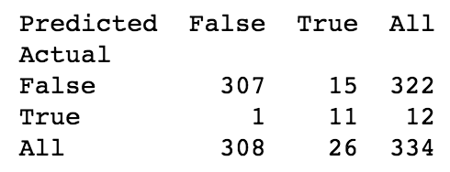
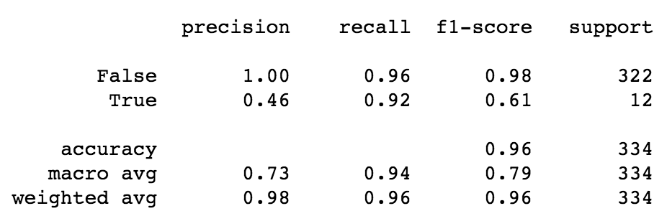
Decision Tree

Slide 10
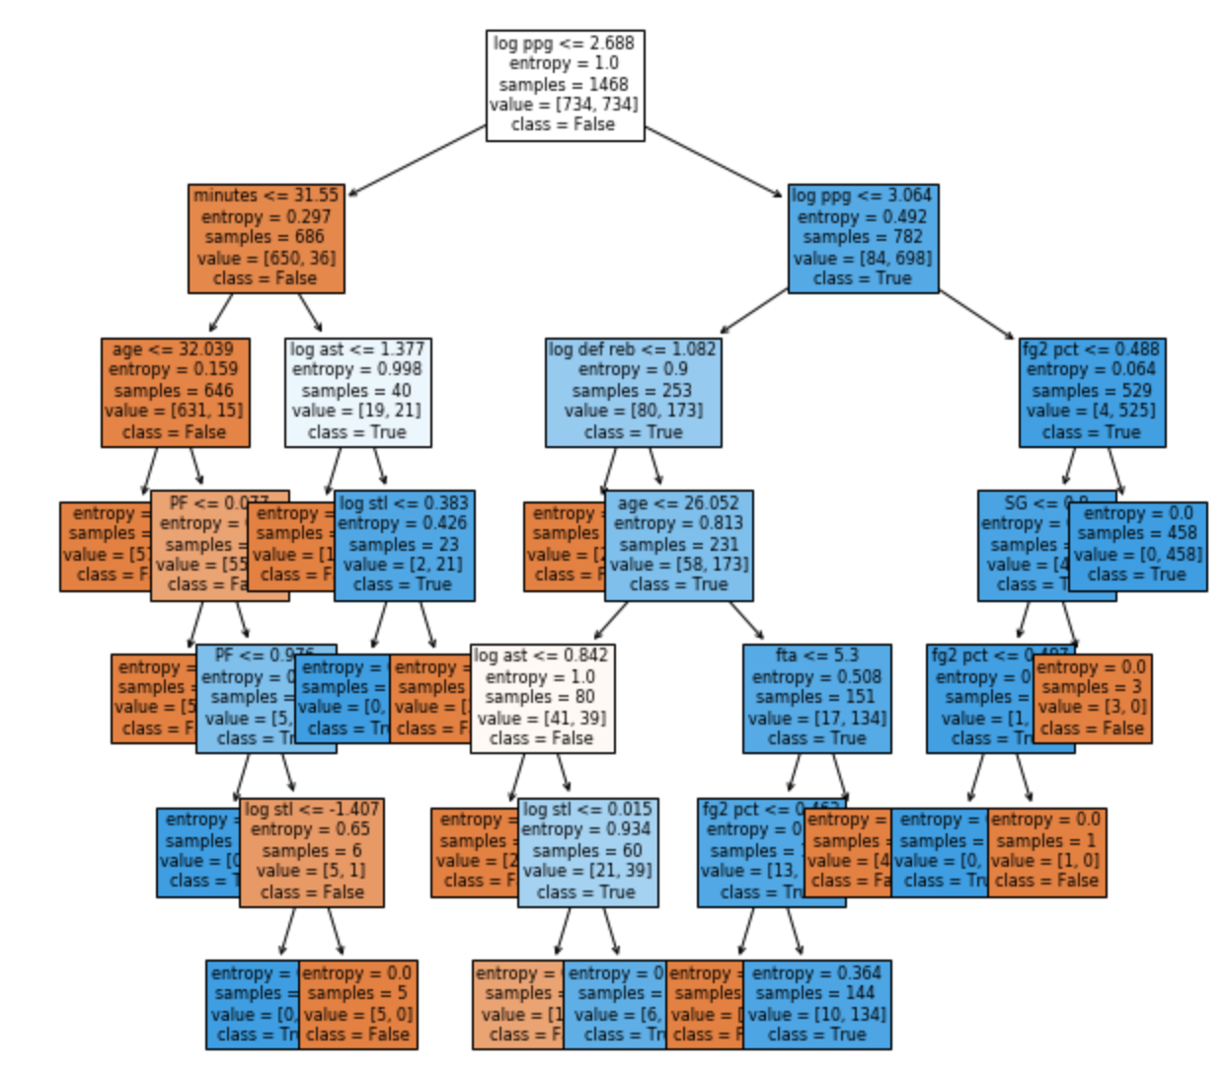
Decision Tree

Slide 11
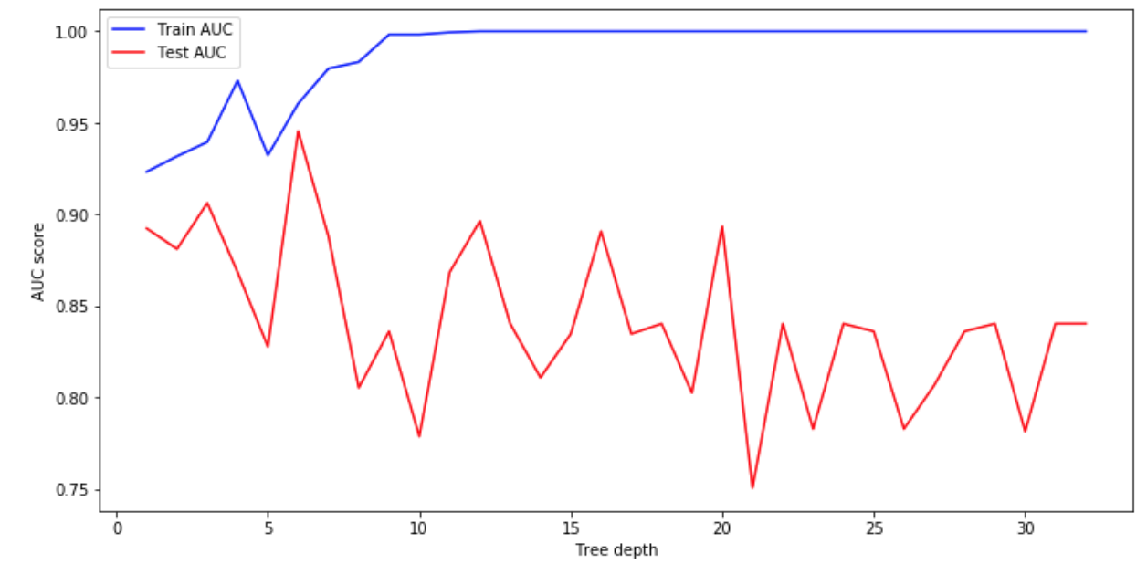
Selecting Optimal Tree Depth

Slide 12
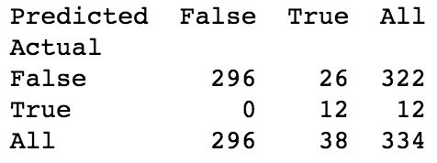
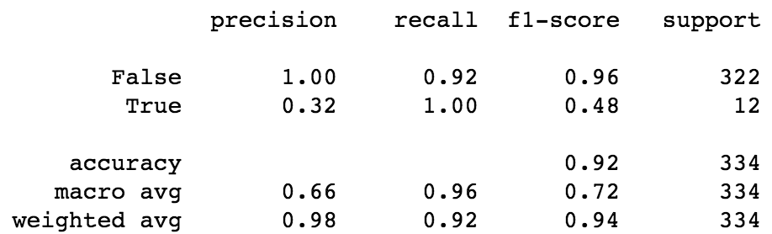
Support Vector Machines

Slide 13
Comparing the Models
SVM managed to correctly classify all the all stars in training data (12) but had the most amount of false positives (26)
Lowest accuracy score of the models (0.92)
Logistic regression and decision tree both correctly classified 11 out of 12 all stars, but log reg. had significantly more false positives (23) than DT (15)
Decision Tree was the best model, had the highest accuracy score (0.96)

